Slide 1
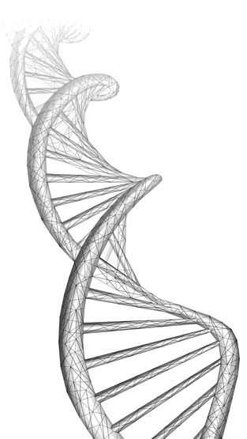
Paper Replication
Machine Learning to Detect Alzheimer’s Disease from Circulating Non-coding RNAs
Nicole Ludwig, Tobias Fehlmann, Fabian Kern, et al
https://doi.org/10.1016/j.gpb.2019.09.004.
(https://www.sciencedirect.com/science/article/pii/S1672022919301573)
By: Ahmed H. Ibrahim

Slide 2
Content
Abstract
Paper Overview
Results Overview
Discussion

Slide 3
Abstract
Blood-borne small non-coding (sncRNAs) are among the prominent candidates for blood-based diagnostic tests. Often, high-throughput approaches are applied to discover biomarker signatures. These have to be validated in larger cohorts and evaluated by adequate statistical learning approaches. Previously, we published high-throughput sequencing based microRNA (miRNA) signatures in Alzheimer’s disease (AD) patients in the United States (US) and Germany. Here, we determined abundance levels of 21 known circulating miRNAs in 465 individuals encompassing AD patients and controls by RT-qPCR. We computed models to assess the relation between miRNA expression and phenotypes, gender, age, or disease severity (Mini-Mental State Examination; MMSE). Of the 21 miRNAs, expression levels of 20 miRNAs were consistently de-regulated in the US and German cohorts. 18 miRNAs were significantly correlated with neurodegeneration (Benjamini-Hochberg adjusted P < 0.05) with highest significance for miR-532-5p (Benjamini-Hochberg adjusted P = 4.8 × 10−30). Machine learning models reached an area under the curve (AUC) value of 87.6% in differentiating AD patients from controls. Further, ten miRNAs were significantly correlated with MMSE, in particular miR-26a/26b-5p (adjusted P = 0.0002). Interestingly, the miRNAs with lower abundance in AD were enriched in monocytes and T-helper cells, while those up-regulated in AD were enriched in serum, exosomes, cytotoxic t-cells, and B-cells. Our study represents the next important step in translational research for a miRNA-based AD test.

Slide 4
Paper Overview
Their Goal:
With the present study they pursue the five main goals to demonstrate that:
miRNAs from NGS studies can be well reproduced by RT-qPCR experiments;
given a reasonable heterogeneity in samples still reproducible measurements in larger cohorts are possible;
miRNAs are also correlated to clinical features such as the MMSE value;
statistical learning approaches with as few as possible features lead to accurate diagnostic results;
the miRNAs likely have functionality in AD via targeting genes.

Slide 5
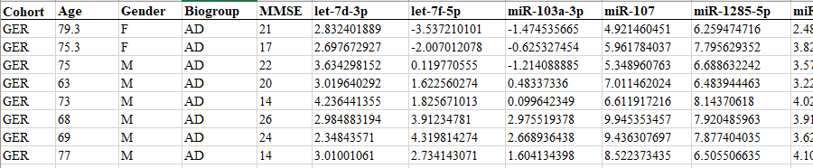
Data Overview
The dataset is provided in the paper in Supplementary Table S1.
Cohorts of the patients are United States (US) and Germany (Ger).
MMSE stands for (Mini-Mental State Examination)
miRNAs Count: 21 known circulating miRNAs. (Our features)
number of samples: 465 individuals.
Biogroup: (Our target - with minor modifications)
Alzheimer’s disease (AD),
mild cognitive impairment (MCI),
other neurological diseases (OND),
and healthy controls (HC)

Slide 6
Replication Overview
Of this study,
The statistical visualizations were replicated; which show correlation, distribution of the cohorts together with their Biogroups
Performance of the LightGBM models are assessed on two cases:
Case 1. Positives = AD, Negatives = (OND, MCI, HC)
Case 2. Positives = AD, Negatives = HC

Slide 7
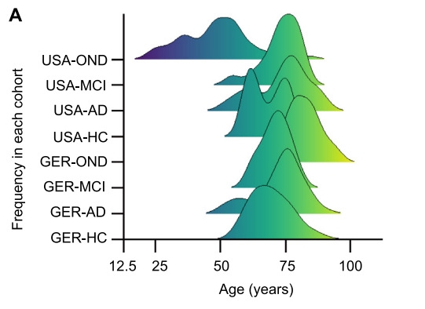
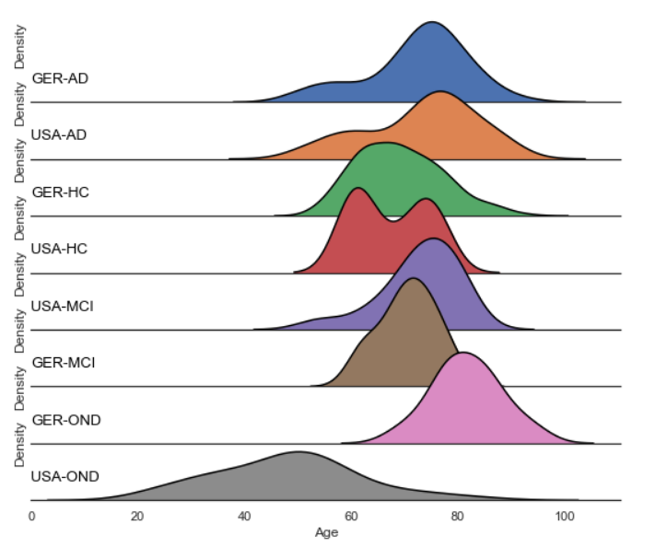
Result Overview - visualization
Figure 1. Distribution of age, gender, diseases, and MMSE
Study
Replication
Histogram for the age distribution in the different cohorts. The diagram shows for each cohort/disease the age distribution. Only the OND group from the US shows a deviation towards younger patients, while all other groups have similar age ranges

Slide 8
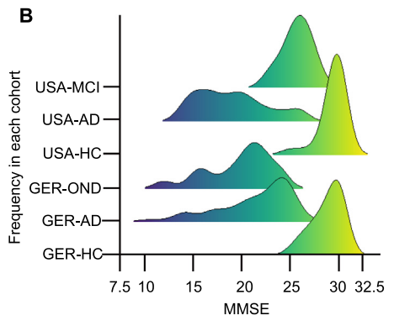
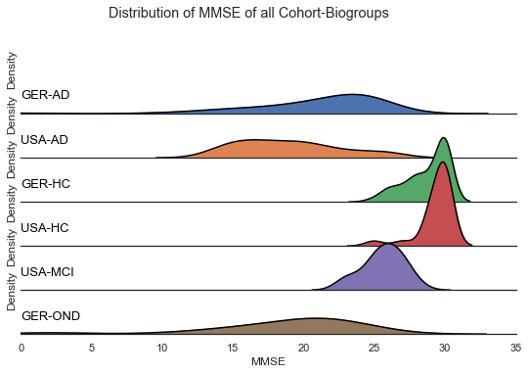
Result Overview - visualization
Figure 1. Distribution of age, gender, diseases, and MMSE
Study
Replication
Histogram for the MMSE values. HCs and MCI patients show significantly larger MMSE values as compared to AD and OND patients.

Slide 9
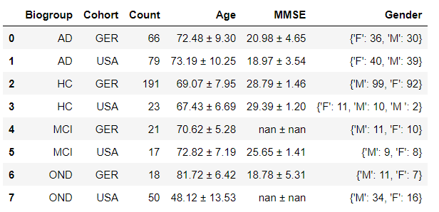
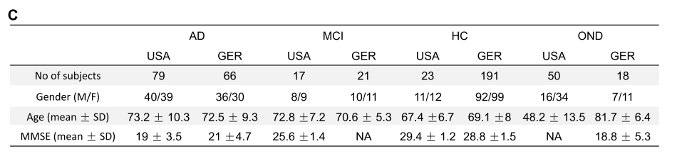
Result Overview - statistical summary
Figure 1. Distribution of age, gender, diseases, and MMSE
Study
Replication
Metrics. For each of the cohorts and diseases, the number of patients in the US and Germany, the mean and SD for age and MMSE as well as the gender distribution are provided. GER, Germany; MMSE, Mini-Mental State Examination; AD, Alzheimer’s disease; OND, other neurological diseases; HC, healthy control; MCI, mild cognitive impairment.

Slide 10
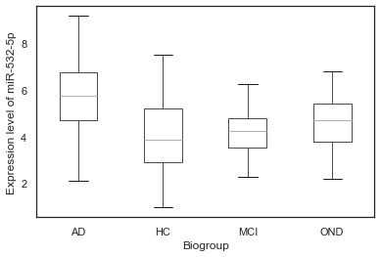
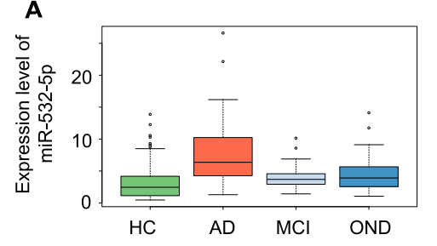
Result Overview - visualization
Figure 2. miRNAs are specifically dysregulated in the four cohorts and are partially co-expressed
Study
Replication
Expression of miR-532-3p. The boxes display the 2nd and 3rd quartile of expression values for miR-532-3p in HC, patients with AD, MCI, or OND. The range of expression values in the four groups is indicated by the error bars with outliers represented by unfilled dots. Median expression of miR-532-3p is indicated as thick black line.
Note: Although their provided data is normalized, We can still see >> AD cohort is overexpressed than others

Slide 11
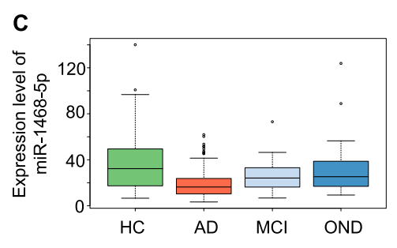
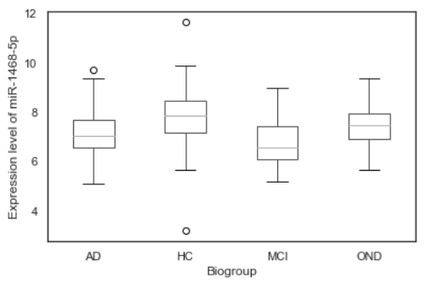
Result Overview - visualization
Figure 2. miRNAs are specifically dysregulated in the four cohorts and are partially co-expressed
Study
Replication
Expression of miR-1468-5p. The boxes display the 2nd and 3rd quartile of expression values for miR-1468-5p in HC, patients with AD, MCI, or OND. The range of expression values in the four groups is indicated by the error bars with outliers represented by unfilled dots. Median expression of miR-1468-5p is indicated as thick black line. PCC, Pearson correlation coefficient.
Note: Although their provided data is normalized, We can still see >> healthy controls (HC) is overexpressed than others

Slide 12
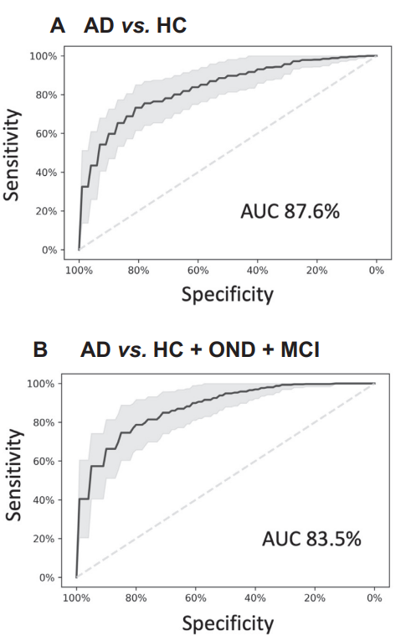
Result Overview - Machine Learning
Figure 4 miRNA classifiers show a high diagnostic performance to detect AD
Study
Replication
LightGbm Model were evaluated using 10 CV of 5 iterations. The used models params are the same as the ones that have been reported in the paper.
CASE #1 result:
Samples: Positives(AD) vs. Negatives (HC, MSI, OND)
AUC of ValidationSets From 10 CV and 5 Iterations - Average = 0.836768, Std = 0.059347
CASE #2 result:
Samples: Positives(AD) vs. Negatives(HC)
AUC of ValidationSets From 10 CV and 5 Iterations - Average = 0.873266, Std = 0.058003
As Noticed; the LightGbm achieved a higher average AUC on Case #2: (AD vs. HC) than Case #1 (AD vs. (HC, MSI, OND )). And the results are almost similar to what have been achieved in the paper.

Slide 13


